Slide 1



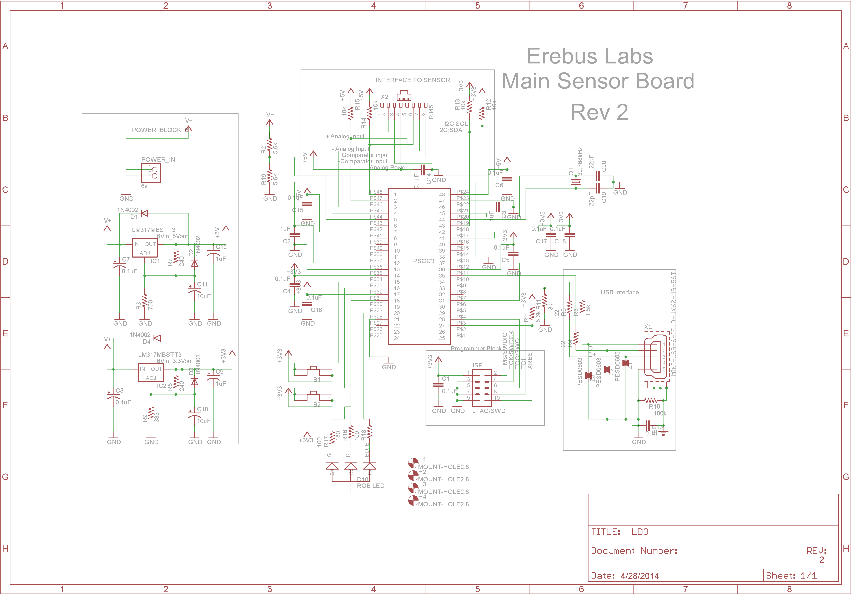
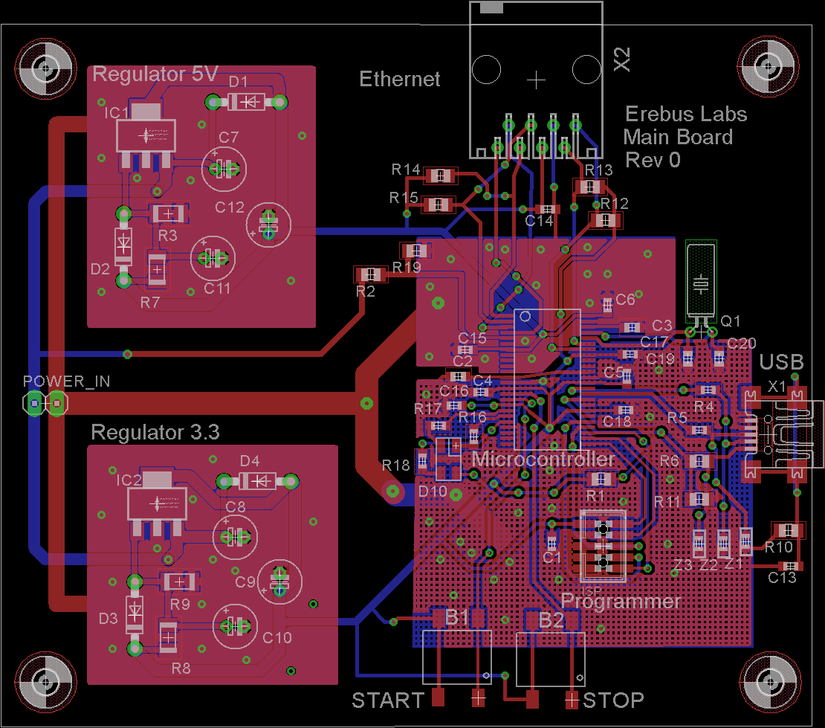




Erebus Labs STEM Sensor
The Reason
Current educational curriculum in the US lacks a focus on Science, Technology, Engineering, and Mathematics (commonly referred to as STEM). Though more emphasis is starting to be placed on STEM education, a major hurdle for that education is simply getting kids interested in STEM topics. Negative interest begins in elementary classrooms where %33 of fourth grade students’ attitudes are already hostile towards science and math with that number increasing to %50 by 8th grade¹. Furthermore, according to the United States department of education, only %16 of American high school seniors are proficient in mathematics and interested in a STEM career².
Surveys performed by the National Center for Education Statistics (NCES) in 2013 showed that 42% of 4th grade students performed at or above proficiency in mathematics which is fundamental to all STEM fields. By 8th grade that proficiency dropped to 36%.
Implementation
The Team
Scott Lawson
Computer Engineering
Max Cope
Electrical Engineering
Chris Clary
Electrical Engineering
Bryan Button
Electrical Engineering
References
Mike Borowczak, Ph.D. - Sponsor
Data Analytics Engineer @ SolidFire / Founder @ ErebusLabs
Andrea Burrows - Sponsor
Assistant Professor of Secondary Education, U. Wisconsin
James E. Morris - Advisor
Professor of Electrical and Computer Engineering
www.becpdx.org/nem/stemconnect.aspx
www.ed.gov/stem
http://nationsreportcard.gov/reading_math_2013
Department of Electrical and Computer Engineering

